Slide 2
PRESENTERS https://baysiderefugeesupport.org/about
JUDY CARROLL co-founder BRASA 2013 and lifelong ALP membership over 50 years, BRASA committee member
KATIE SHAFAR semi retired nurse who worked on Nauru 2015, came back then found BRASA in 2016, BRASA committee member, Membership Secretary

Slide 3
Definition – Refugee
Refugee is a person who has been processed and granted refugee status because they have fled war, violence, conflict or persecution and have crossed an international border to find safety in another country. They often have had to flee with little more than the clothes on their back, leaving behind homes, possessions, jobs and loved ones.

Slide 4
Definition – Asylum Seeker
An asylum seeker is a person looking for protection because they fear persecution, or they have experienced violence or human rights violations. They are waiting to be processed for a decision to enable them to become refugees. Many In Australia have been waiting up to 10 years, with no work or study rights.
Eg The family with the autistic child is a case in point – with no access to NDIS. She was only allowed to attend special school at age 6. the family managed her at home with NO support for 6 years.

Slide 5
Watch out for government rhetoric!!
Demonized boat people starting at Tampa 2001 – we are all boat people / descendants of…….
It is not illegal to seek asylum (UN charter 1951) everyone has the right to flee from persecution
Vindictive cruel government eg Biloela family
Queue – there is no queue – it a humanitarian lottery

Slide 6
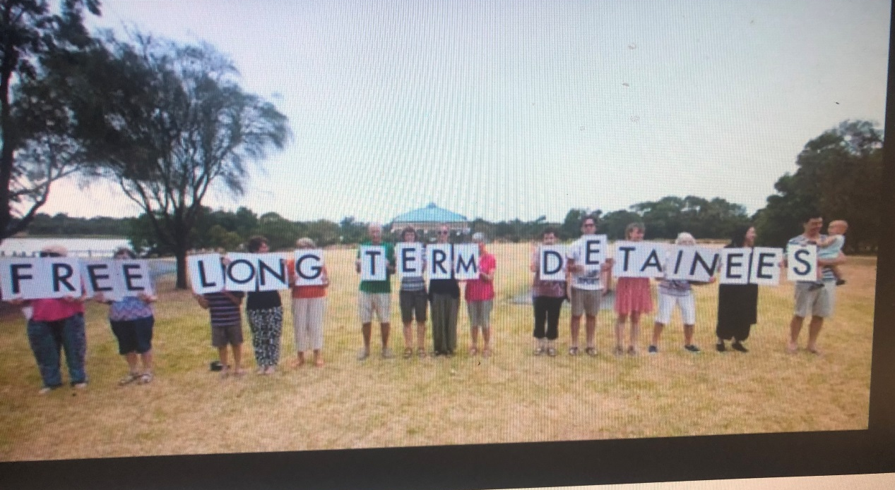
BRASA Roadside Protests

Slide 7
BRASA KEY ACHIEVEMENTS 2021
Collated by Geraldine Moore BRASA President,
Founder BRASA 2013
Highlights of what we do in a snapshot
Crowd funding for Mahdi Arman ($20K raised so he can leave Indonesia after x years and settle in Canada (led by Geraldine)
Several plant stalls x 5 have raised over $6000
Weekly Roadside vigils with figurines of Kopika and Tharnicaa
Updating BRASA website including Resources Guide by Kevin Bain (long time BRASA member)

Slide 8
BRASA FINANCIAL DONATIONS 2021
organisations providing legal assistance of $3,272
organisations providing housing and living expenses of $2,600
organisations providing food, groceries of $3,100
individual refugees with rent, car expenses, swimming lessons, dental treatment, mobile phones, clothing and shoes: $7,509
Mahdi Arman’s campaign for re-settlement in Canada: $2196 (plus the crowd funding target)

Slide 9
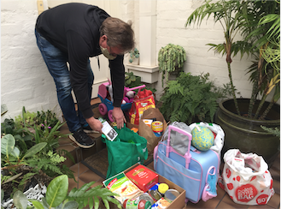
Material Aid

Slide 10
Member actions 2019 – to present
Judy and Frank have for years supported V and S - linked them with Red Cross, supported them for months with rent via BRASA, Franks has done English lessons, taken them away for a weekend, joined BRASA BBQ’s
Katie, Stan and BRASA organized a working bee March 2021, for family in BM in community detention with severely autistic non-verbal child now age 9. Big clean up of house front / back yard, Builder Lawrence donated his time and skill to build a fenced in safe deck for child , building materials donated by BRASA over $400, skip cost $320 (NDIS)
Geraldine and others supported a single Sri Lankan woman with 2 PS age girls in St Kilda with English, friendship, material aid……..there are countless stories

Slide 11
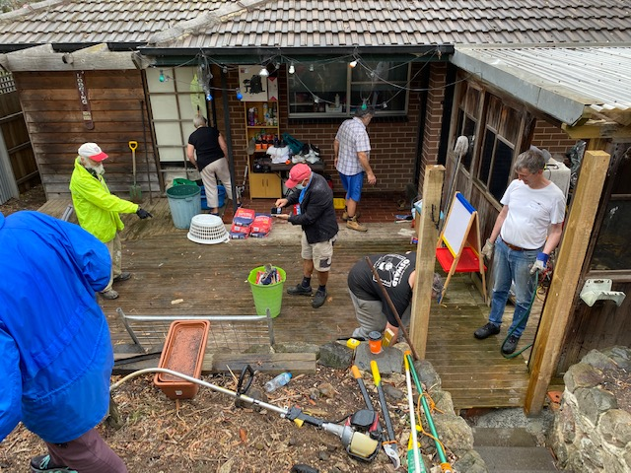
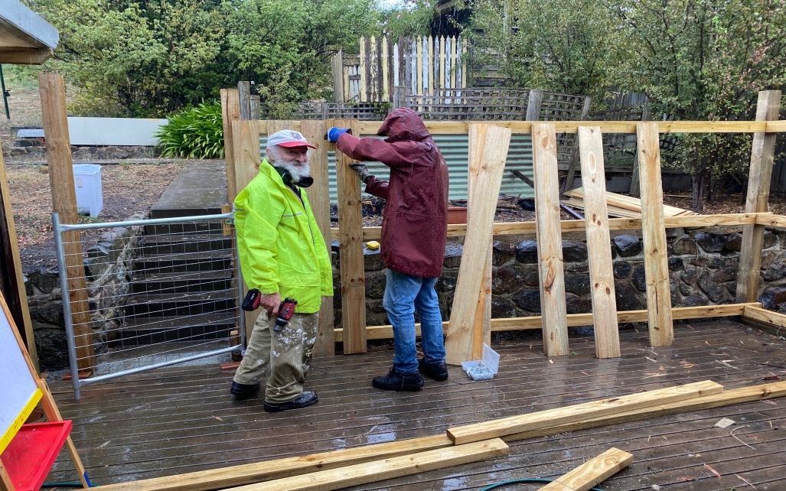
Working Bee Broadmeadows March 2021

Slide 12
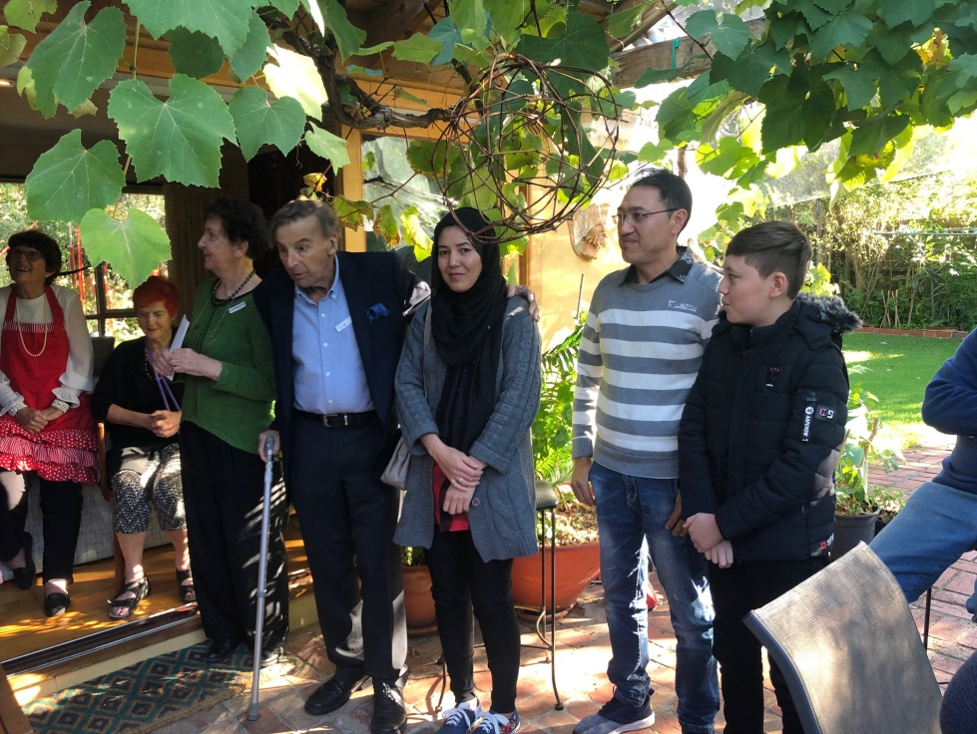
Family Reunion after 11 years apart Amin Masooma Yasir

Slide 13
BRASA members have provided accommodation
One member has donated to Brigadene AS Project Sister Brigid a 2 BR flat to house AS
Another member has donated as above at nominal rent a 1BR flat – worked as a “community worker” with him for several months to help him get used to life outside detention (9 years) – sorted medical appointments, his meds, sorted psychiatrist support together with other BRASA members

Slide 14
What do we want
Close offshore detention centres
Everyone to have permanent visa, no more TPV eg Hasaras
Expedite processing for 14,000 AS stuck in Indonesia for years (no work, no education, extreme poverty) eg Cisuara
Family reunification A and M and Yasir 11 yrs! (April 2021)
Canadian model eg short processing done in community

Slide 15
Afghani Refugees – Shame Australia!! 2022

Slide 16
Once released – what now
Released on a Friday night – 15 mins to get their belongings together - after 9 years incarceration!!!
Taken to hotel in Albion Melbourne with
$ 320 to last 3-4 weeks – no money management skills / support and $1000 from ASRC
No proper training for life on the outside
Need help with My Gov, ABN, Myki MC, medication
Example HK and Lyrica
Little / no case work support eg AMES LwB

Slide 17
Very damaged people – many who will likely never be well enough to work
Serious mental health issues / sleep / depression / anxiety – PTSD / paranoia
Vomiting blood – due to chronic terrible food, sanitation, overcrowding, poor medical services
Hunger strikes resulting with long term / chronic health problems and a myriad of medications with little / no review

Slide 18
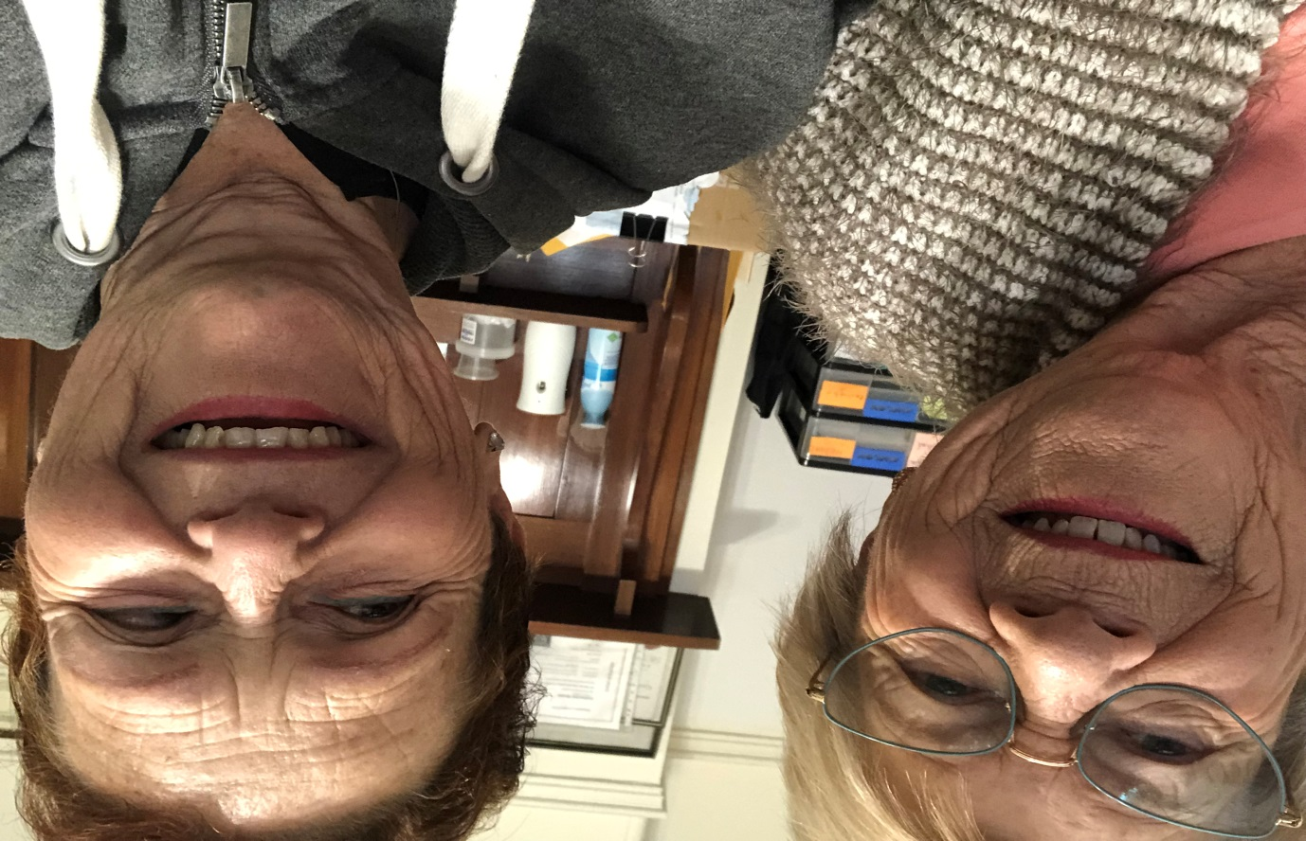

Slide 19
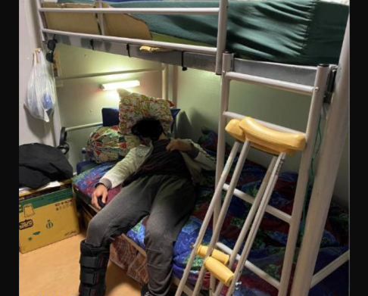
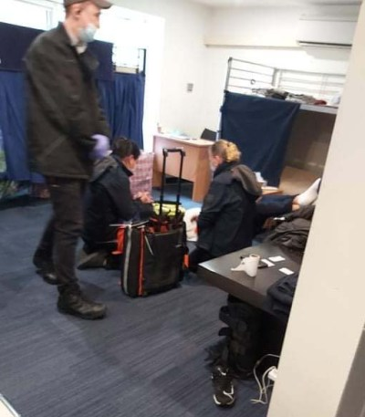
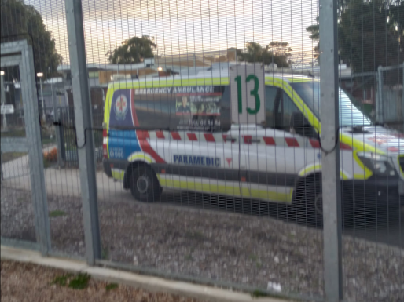
Hunger Strikes – reprehensible suffering

Slide 20
What do we want the government to do
200 asylum seekers / refugees remain in Nauru (moved from PNG) demand their release
Release the Murugappan family back to Biloela QLD (Priya Nades Kopika and Tharnicaa)
Increase Afghan refugee intake esp those on TPV for years
Provide proper visas for those held in community detention with no work / education rights – permanent protection
Release all detainees from Park Hotel (done April 7th 2022) and other on shore detention centres around Australia eg MITA Melbourne Immigration Transit Accommodation – Broadmeadows

Slide 21
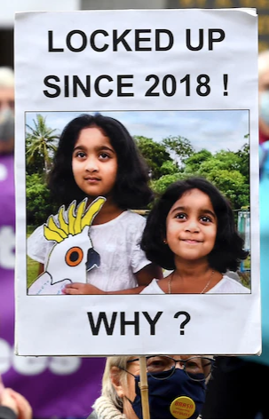
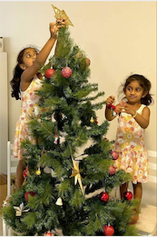
Tharnica and Kopica

Slide 22
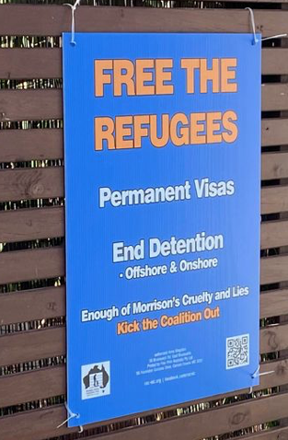
WHAT YOU CAN DO
- Write letters – handwritten / posted to
MP – ongoing
Write letters to “The Age” Letters to Editor
Provide food material aid to BASP / FOR / ASRC / non perishables
Provide donations to the above – if possible ongoing
Have fund-raisers
Keep at it!!!

Slide 23
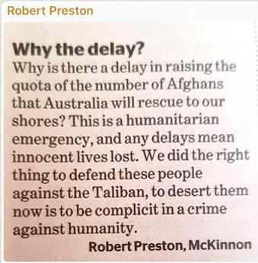
BRASA MEMBERS LETTERS

Slide 24
BRASA MEMBER LETTER April 2022

Slide 25
Craig Foster You tube National Press Club
Craig Foster National Press Club Address
https://www.youtube.com/watch?v=Up5i3QymWhU&t=2928s

Slide 26
Sister Brigid Arthur BASP Palm Sunday Speech April 10th 2022
I offer mine with a few What ifs.
What if
• What if Australia declared an amnesty or act of grace for all those trapped in detention or in limbo in the community and gave everyone a permanent protection visa. Its been made so complex lets start again with a clean slate.
• What if an Australian government had the moral compass that we have been hearing about to outlaw any immigration detention in the future – close all of them and pass a law never to reopen them.
• What if all those asking for asylum in Australia were given access to housing and income support – with work rights for all who can work and medical care for those who can’t.
• What if we did away with Border Force or left it dealing with submarines and the like and having nothing to do with people seeking asylum
• What if instead we had a small department called ensuring a just welcome for all fleeing from persecution, violence and poverty
• What if Australia never again put itself in the humiliating position of asking another country like New Zealand or the USA or Canada to take asylum seekers on our behalf
• What if Australia was recognized as a country of compassion and decency with a reputation as a human righted based state.
• What if next Palm Sunday is a time for rejoicing because these big changes have happened – or are in process.

Slide 27
Books to read
Escape from Manus by Jaivet Ealom 2021
The awe-inspiring story of the only person to successfully escape from Australia’s notorious offshore detention centre on Manus Island.
No Friend but the Mountains by Behrouz Boochani 2019
Harrowing account of life on Manus, written from Manus Prison cruel targeted regime to dehumanize all done on an Iphone with sms messages and recordings to Dr Omid Tofighian
After the Tampa Refugees by Abbis Nazari 2021
Abbis an 8 yo when he and his family were put on the Tampa. He is now a Fulbright Scholar and tells of the many successes of all those former Tampa refugees who went to NZ; e.g. police officers, teachers etc .

Slide 28
What now……
Join BRASA $25 per annum subscription
(Contact Membership Secretary Katieshafar@gmail.com)
0408 102 552
OR
Join Friends of BRASA
Both will receive monthly email newsletters
Be as active / involved as you are able, in your email / sms let me know what is your preference
Thankyou

